Slide 1
CIB Mango Tree
DETECTING COORDINATED BEHAVIOR ON SOCIAL MEDIA
Long Hai Huynh
The George Washington University
Capstone Project - Fall 2025

Slide 2
The “Black Box” Problem
The Threat: Coordinated Inauthentic Behavior (CIB) is scaling rapidly
The Blind Spot: We lack “Ground Truth” labels. We don’t know who the bad actors are
The Question: Without labels, how do we scientifically distinguish a coordinated attack from organic trend?

Slide 3
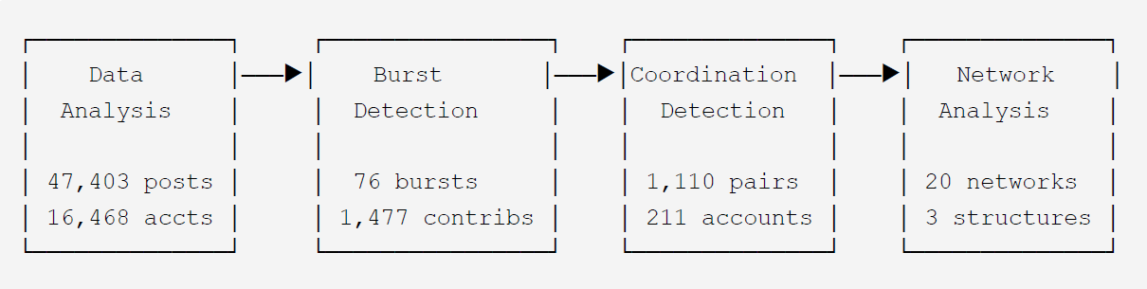
The Methodology
A 4-stage pipeline built on 47,403 Truth Social posts

Slide 4
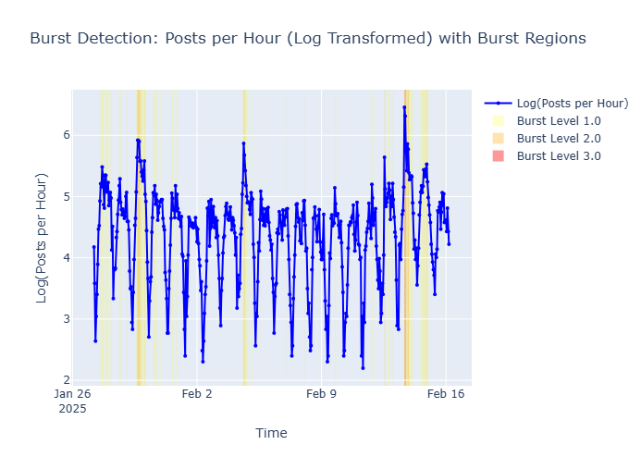
Burst Detection
Kleinberg’s Algorithm: Identifies time windows where activity spikes above baseline
Core Idea: Contributor Selection
The Result: we filtered out casual users, reducing noise from thousands of users to just active few hundred participants in bursts.

Slide 5
Coordination Analysis
I tested 5 signals in a “Phase Additive” framework:
Phase 1-4 (Accepted):
✔ Content Similarity
✔ Hashtag Coordination
✔ URL Sharing
✔ Retweet Amplification
✔ Temporal Synchronization
Phase 5 (Rejected):
Signal: “Mechanical Posting”
Result: Double detection (+105%) but introduced False Positives due to timezone, behavioral coincident.

Slide 6
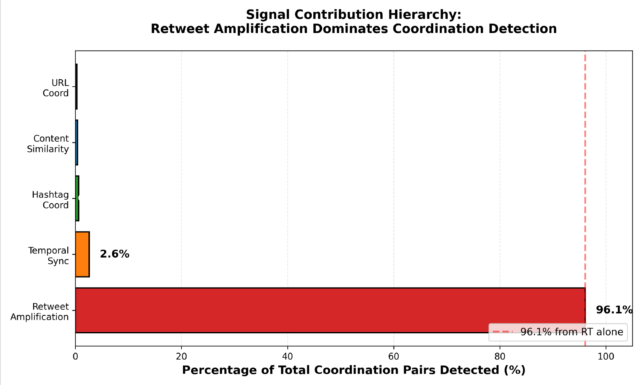
Key Findings: Signal Hierarchy
Retweets (96.1%): The “smoking gun.” The primary mechanism of coordination.
Content signals (~1.3%): Surprisingly low impact. Coordinated actors rarely copy and paste text exactly

Slide 7
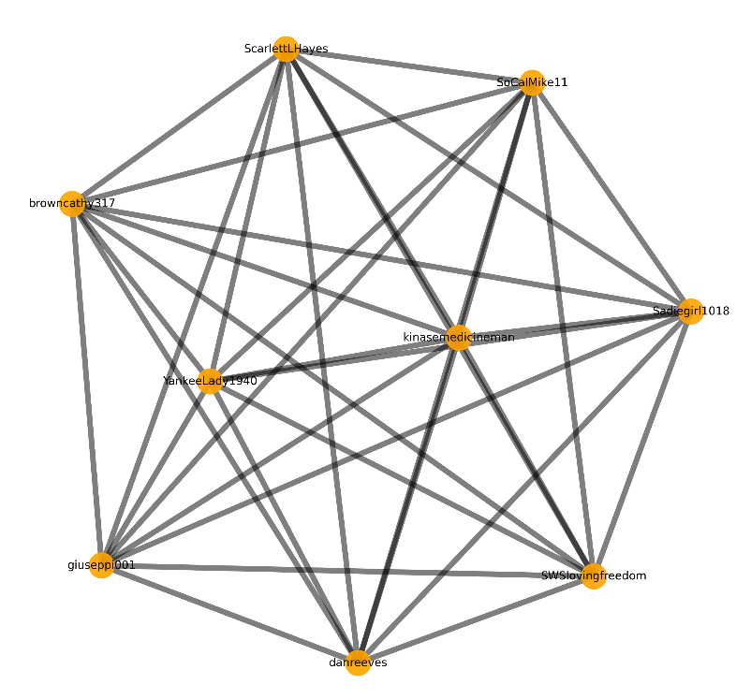
From pairs to Networks
Input: 1,110 Coordination Paris detected.
The Logic: Pairs become Weighted Edges in NetworkX
Edge Weight: Maximum Confidence score
Result: Collapsed pairs into 20 distinct Connected Networks

Slide 8
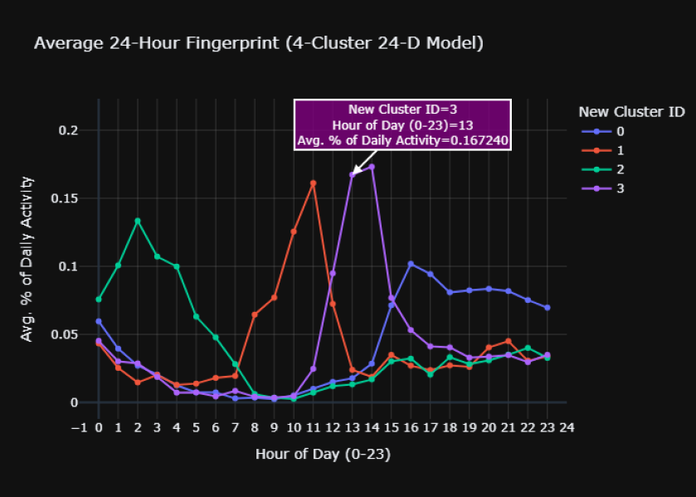
Alternative: Temporal Clustering
Do bots share “Temporal Personas”?
Method: K-Means Clustering
Result: found 4 behaviors
Limitation: Without original timezone metadata (UTC issue), we cannot verify if this is coordination

Slide 9
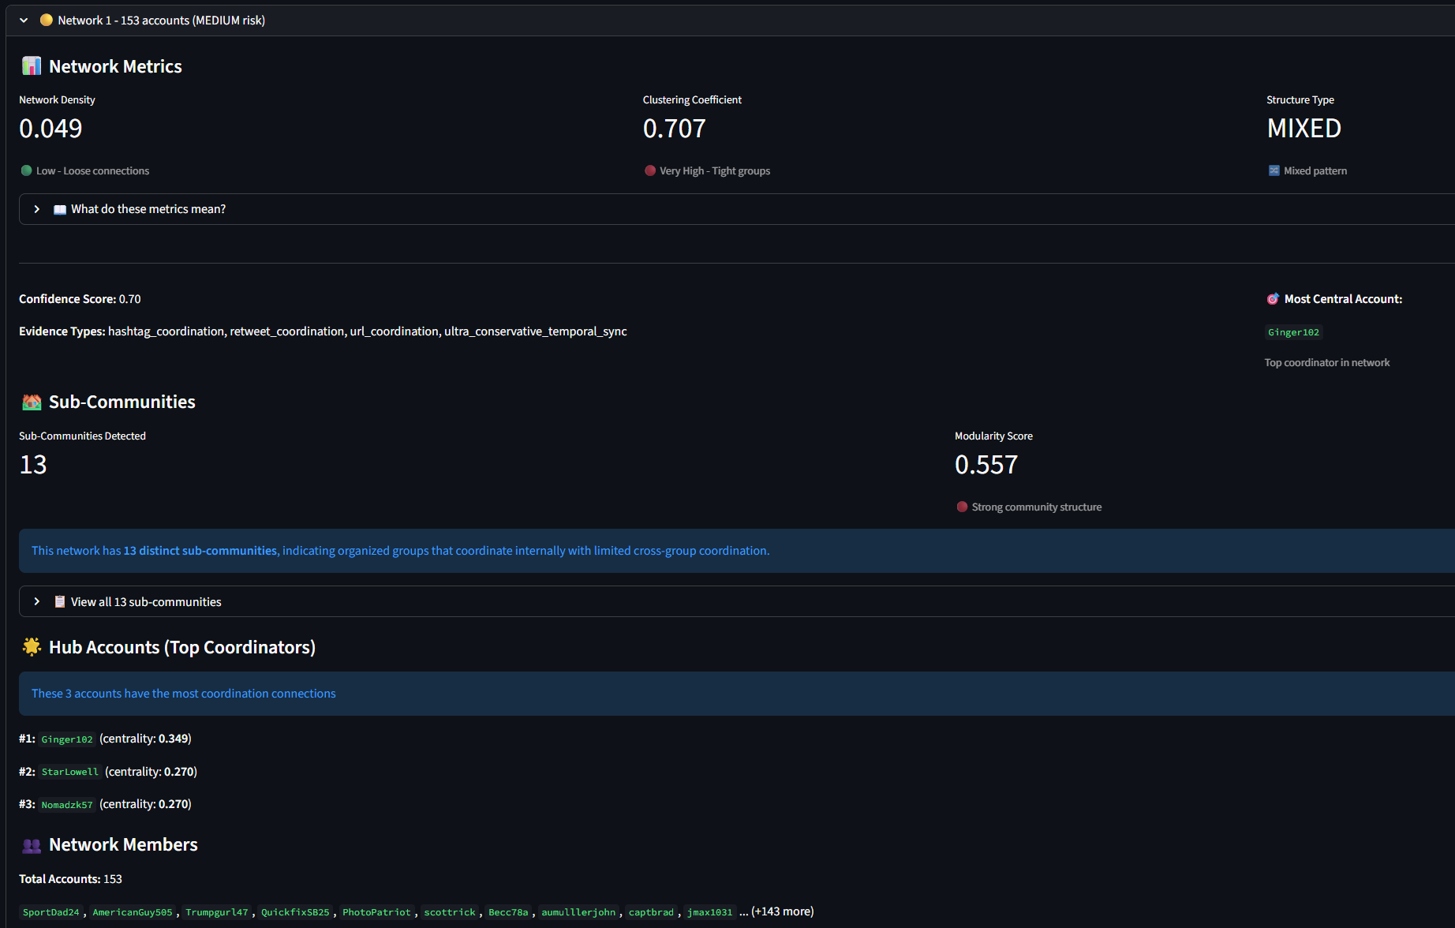
Network Analysis
We detected 20 networks
Network 1 is (153 accounts) is dominant
Conclusion: organized sub-communities, not a random botnet

Slide 10
The Dashboard

Slide 11
Conclusion
Retweets are King: Retweet amplification accounts for 96.1% of detections. Complex content analysis adds minimal value.
Rigor over Quantity: We rejected behavioral patterns (Phase 5) because precision matters more than high detection counts.
Coordination is not random

